Slide 1

Laravel MVC Architecture and Structure
By Min Thet Naing

Slide 2
Laravel MVC Architecture
By Min Thet Naing

Slide 3
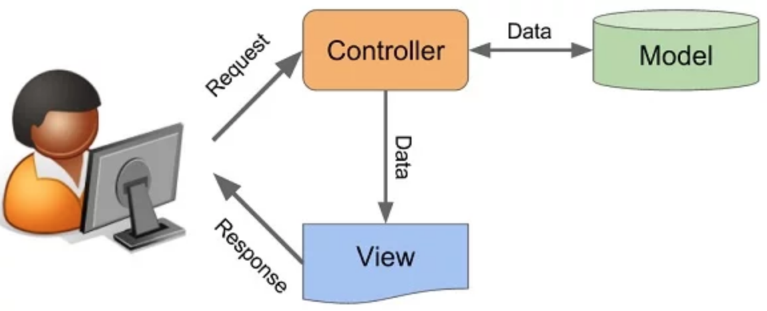
By Min Thet Naing

Slide 4
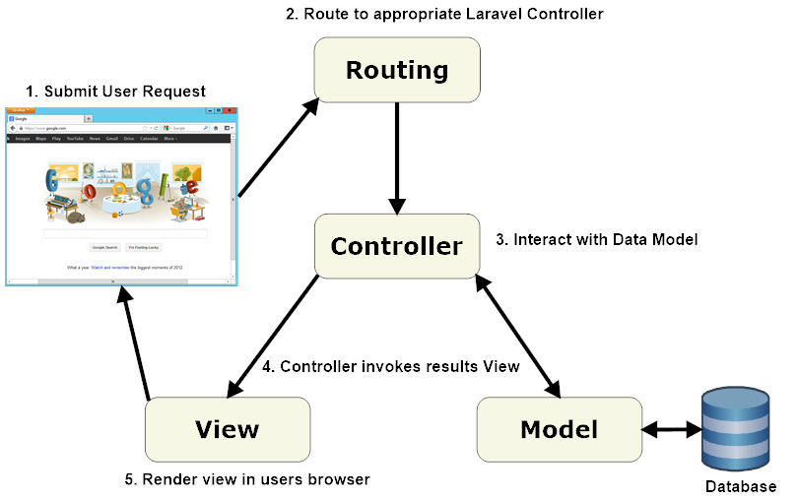
By Min Thet Naing

Slide 5
Laravel Structure
By Min Thet Naing

Slide 6
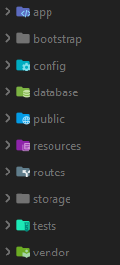

By Min Thet Naing

Slide 7

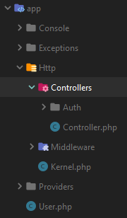
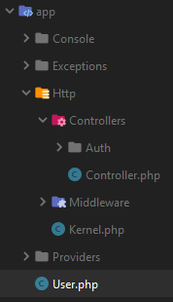

By Min Thet Naing

